Slide 1
eCampusExplorer
An Immersive VR Campus Tour
Aman Sunesh, Ashmit Shankar Mukherjee, Richmond Agyenim-Boateng

Slide 2
01
02
03
INTRODUCTION
CONCLUSION
PROJECT DEVELOPMENT
Problem Statement
Objectives
Features
Timeline
Scripts
Features
Future
Reflections
Contributions

Slide 3
01
Introduction

Slide 4
Problem Statement
Core Problem: Physical and geographical barriers prevent individuals from visiting and experiencing potential campuses.
Consequence: Many students struggle with making informed educational decisions due to inability to travel for campus visits.
Target Audience: Prospective students, parents, and educators.
Benefit: Enhances accessibility and aids decision-making in higher education through advanced VR technology.
Goal: Bridging the gap between prospective students and campus experience, irrespective of location.

Slide 5
Objectives
Immersive Exploration: Offer a fully immersive VR campus tour of NYU Abu Dhabi, enabling lifelike exploration of all key facilities, giving users a sense of physical presence.
Accessibility for All: Ensure tours are accessible globally, with features like audio descriptions and text-to-speech, catering to users including those with disabilities.
Informative Insights: Provide detailed information on campus locations and heritage with pop-ups and narrations for a comprehensive understanding.
User-Friendly Design: Develop an intuitive interface, easy for users of all ages and technical backgrounds.

Slide 6
Features
360° Views
Interactive Navigation Arrows
Right-Hand Interaction System
Information Boxes:
AI-Generated Audio Narration:
Multisensory Exploration:
eCampusExplorer offers a 360-degree view of each scene, providing an immersive experience that mimics physical presence on the campus.
Users navigate through scenes using intuitive arrows for smooth transitions, exploring the campus at their own pace.
A virtual cylinder on the user's right index finger interacts with navigation arrows, guiding them through the virtual environment.
Strategically placed information boxes offer details about campus landmarks, enhancing understanding of each location.
Incorporates AI-generated audio narrations from ElevenLabs, providing dynamic auditory insights into campus locations.
The combination of visual, informational, and auditory elements offers a comprehensive and engaging virtual tour experience.

Slide 7
02
Project Development

Slide 8
Project Timeline
STEP 1
STEP 3
STEP 5
STEP 2
STEP 4
Image Integration in Unity
Adding media and final touches
Capturing 360 degree images of the campus
Script development
Testing

Slide 9
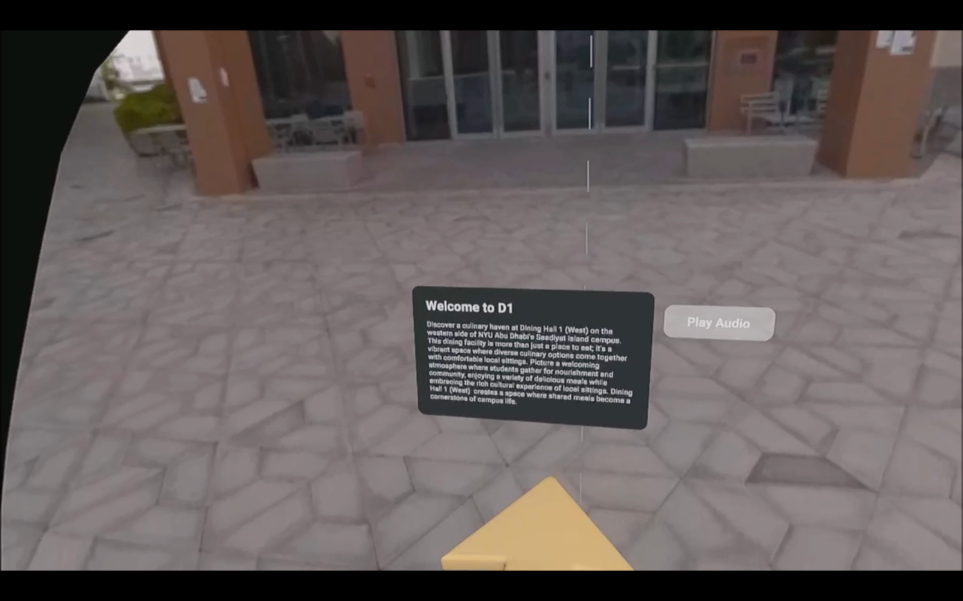
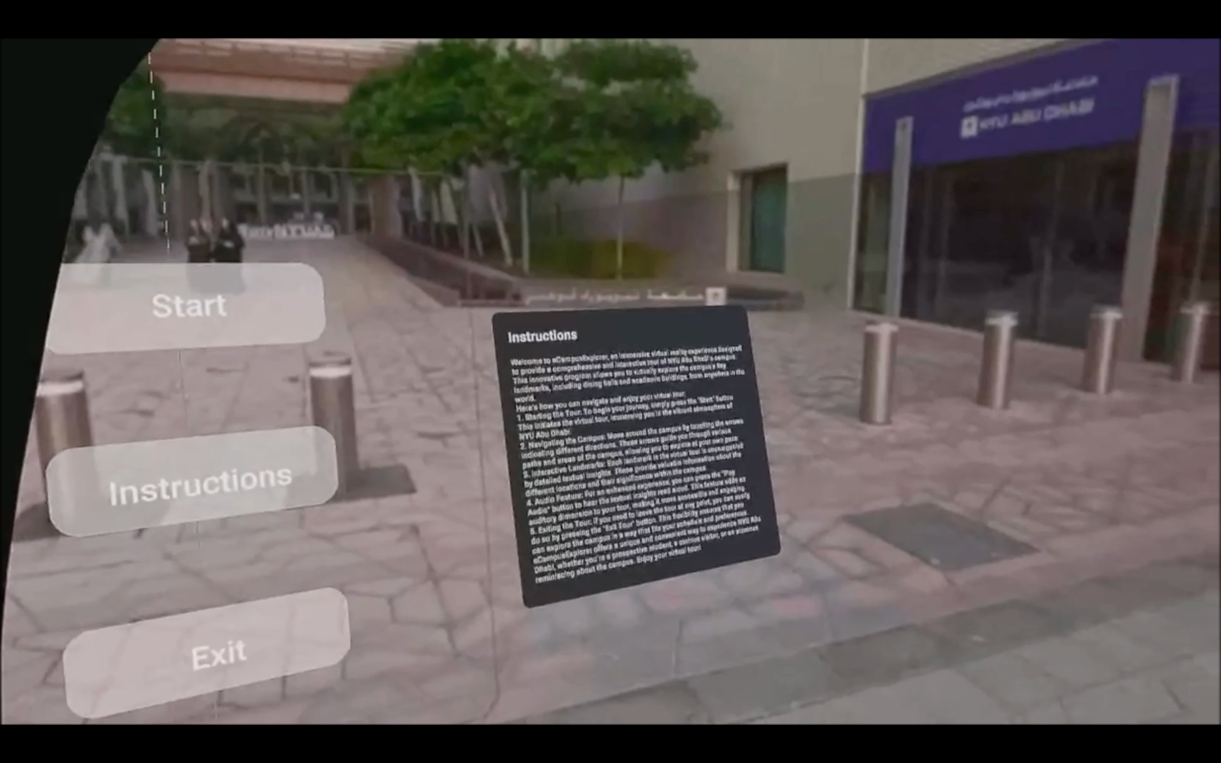
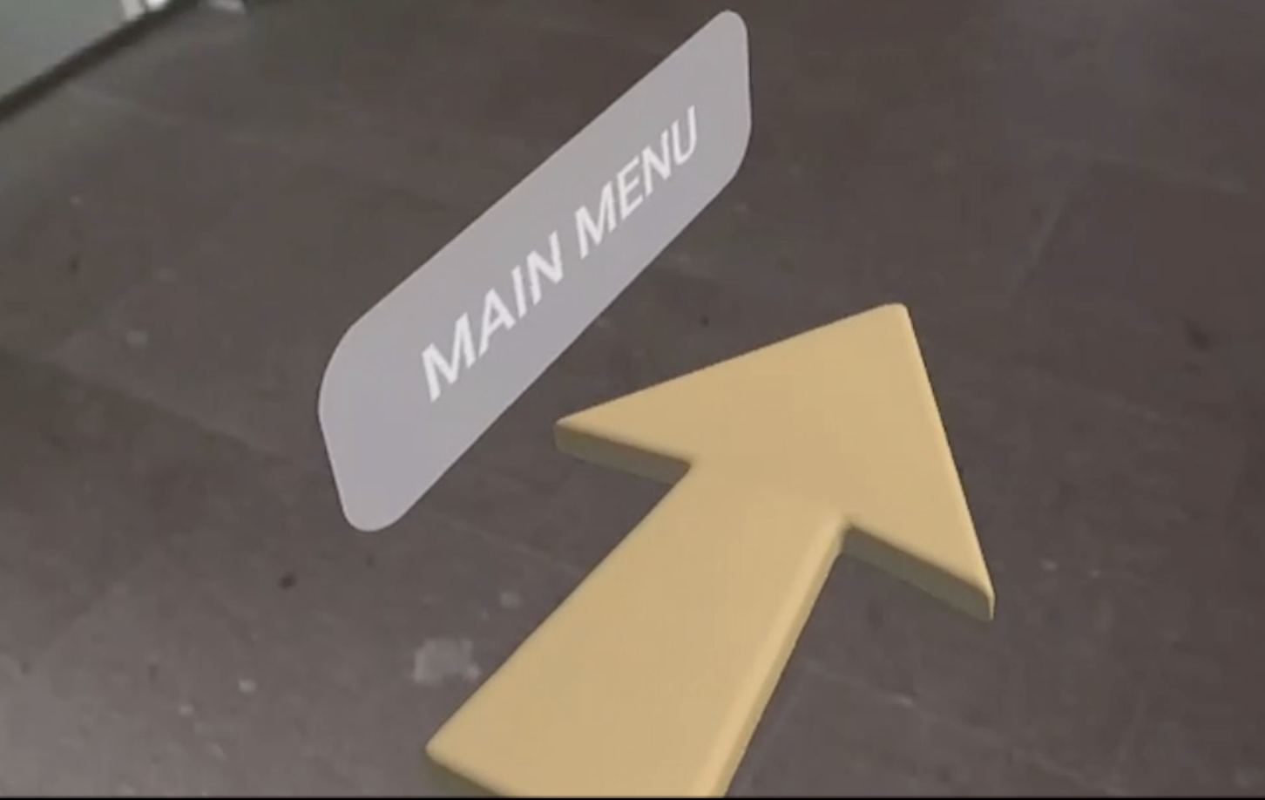
Various Project Components
Text & Play Audio Button
Main Menu
Directional arrow with main menu button

Slide 10
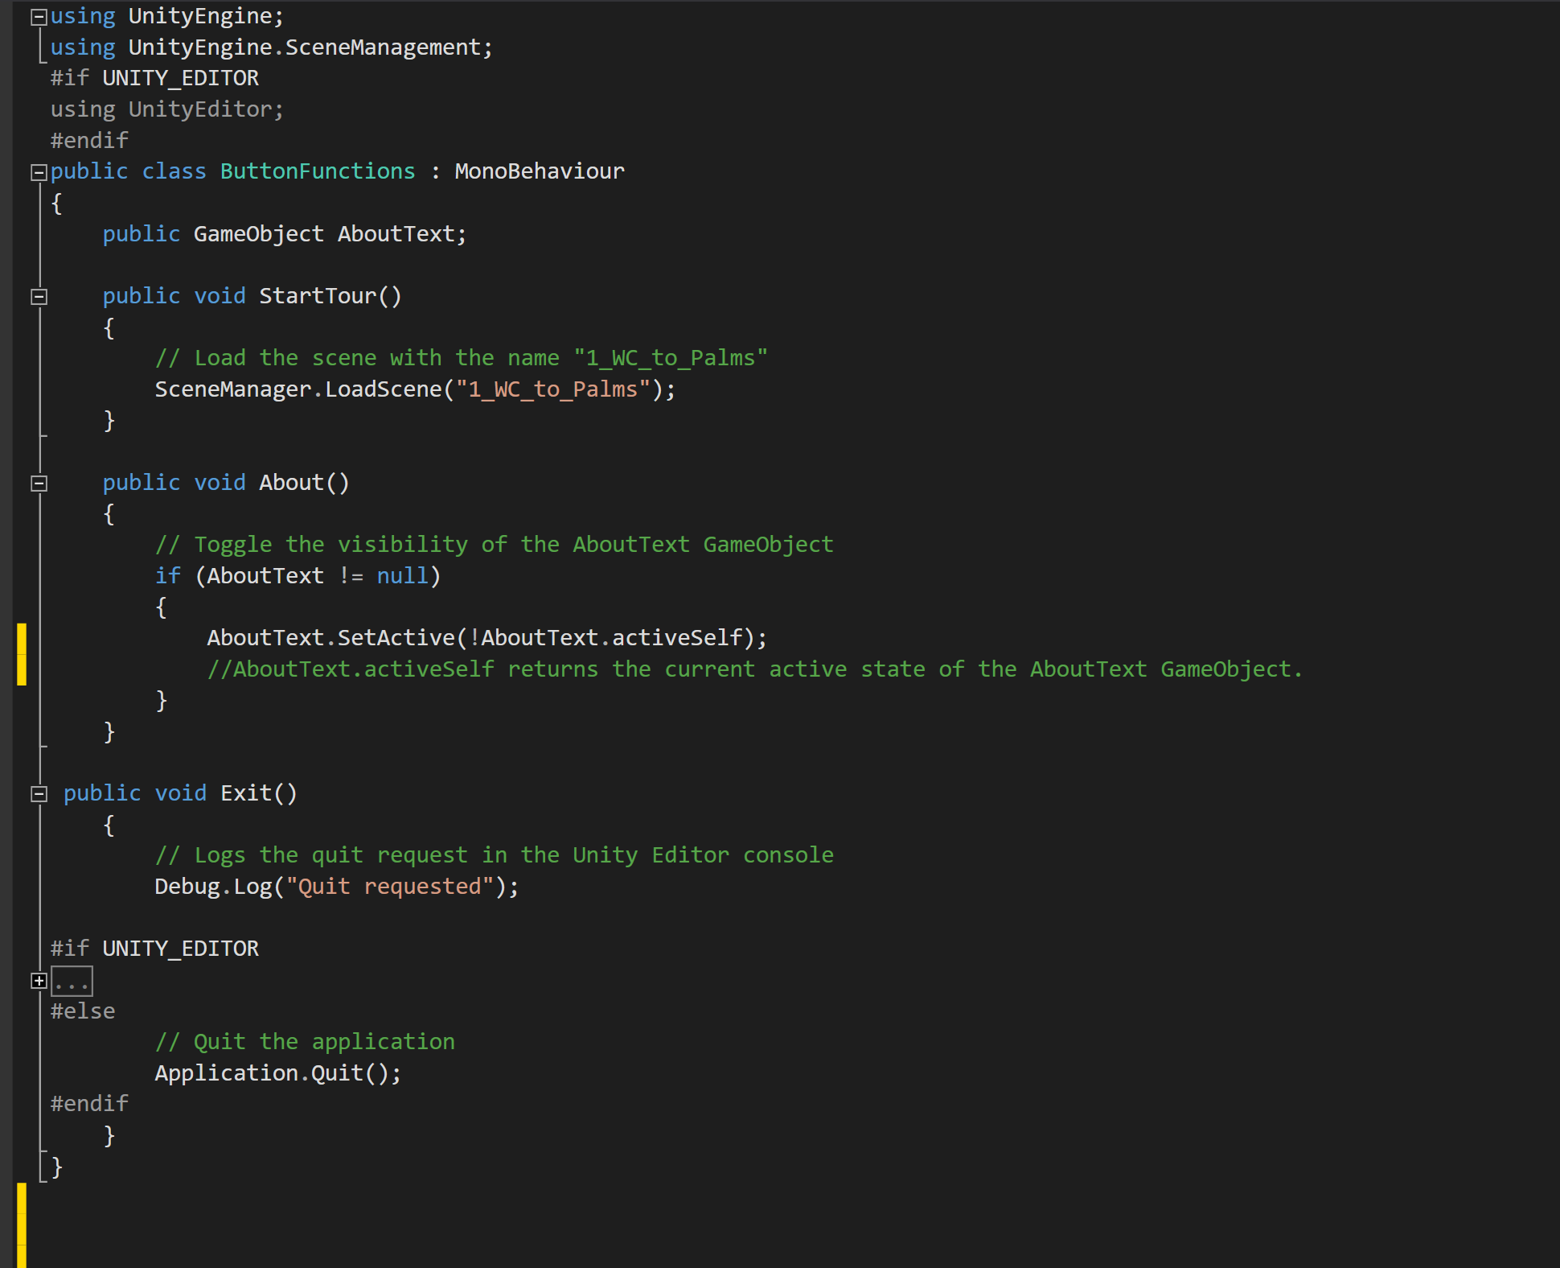
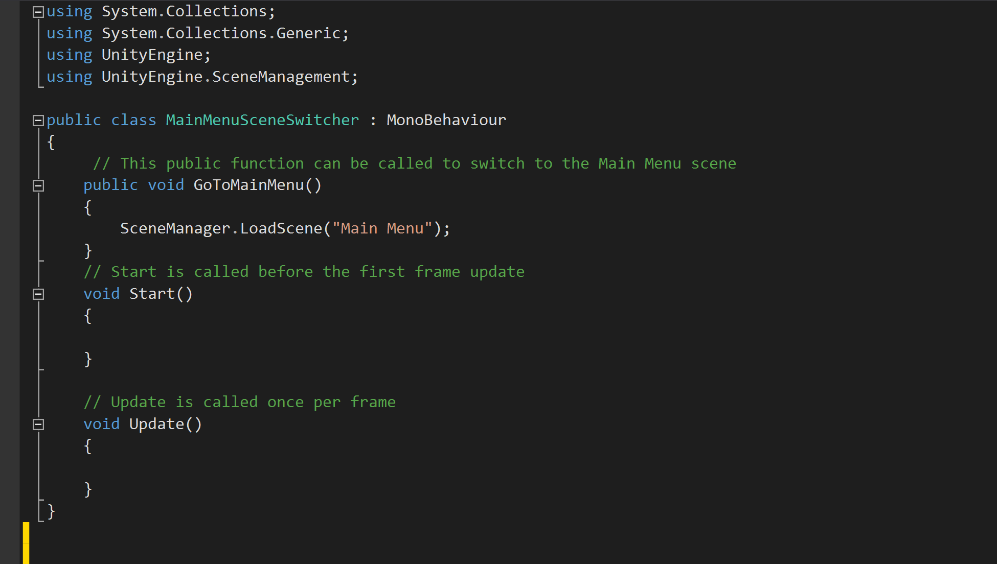
Main Menu Script
Script for Main Menu Button

Slide 11
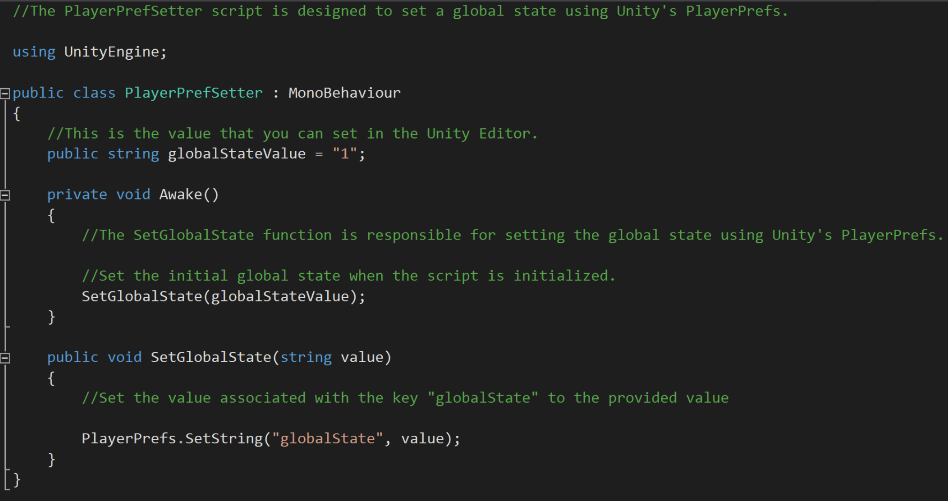
Player Preference Setter Script

Slide 12
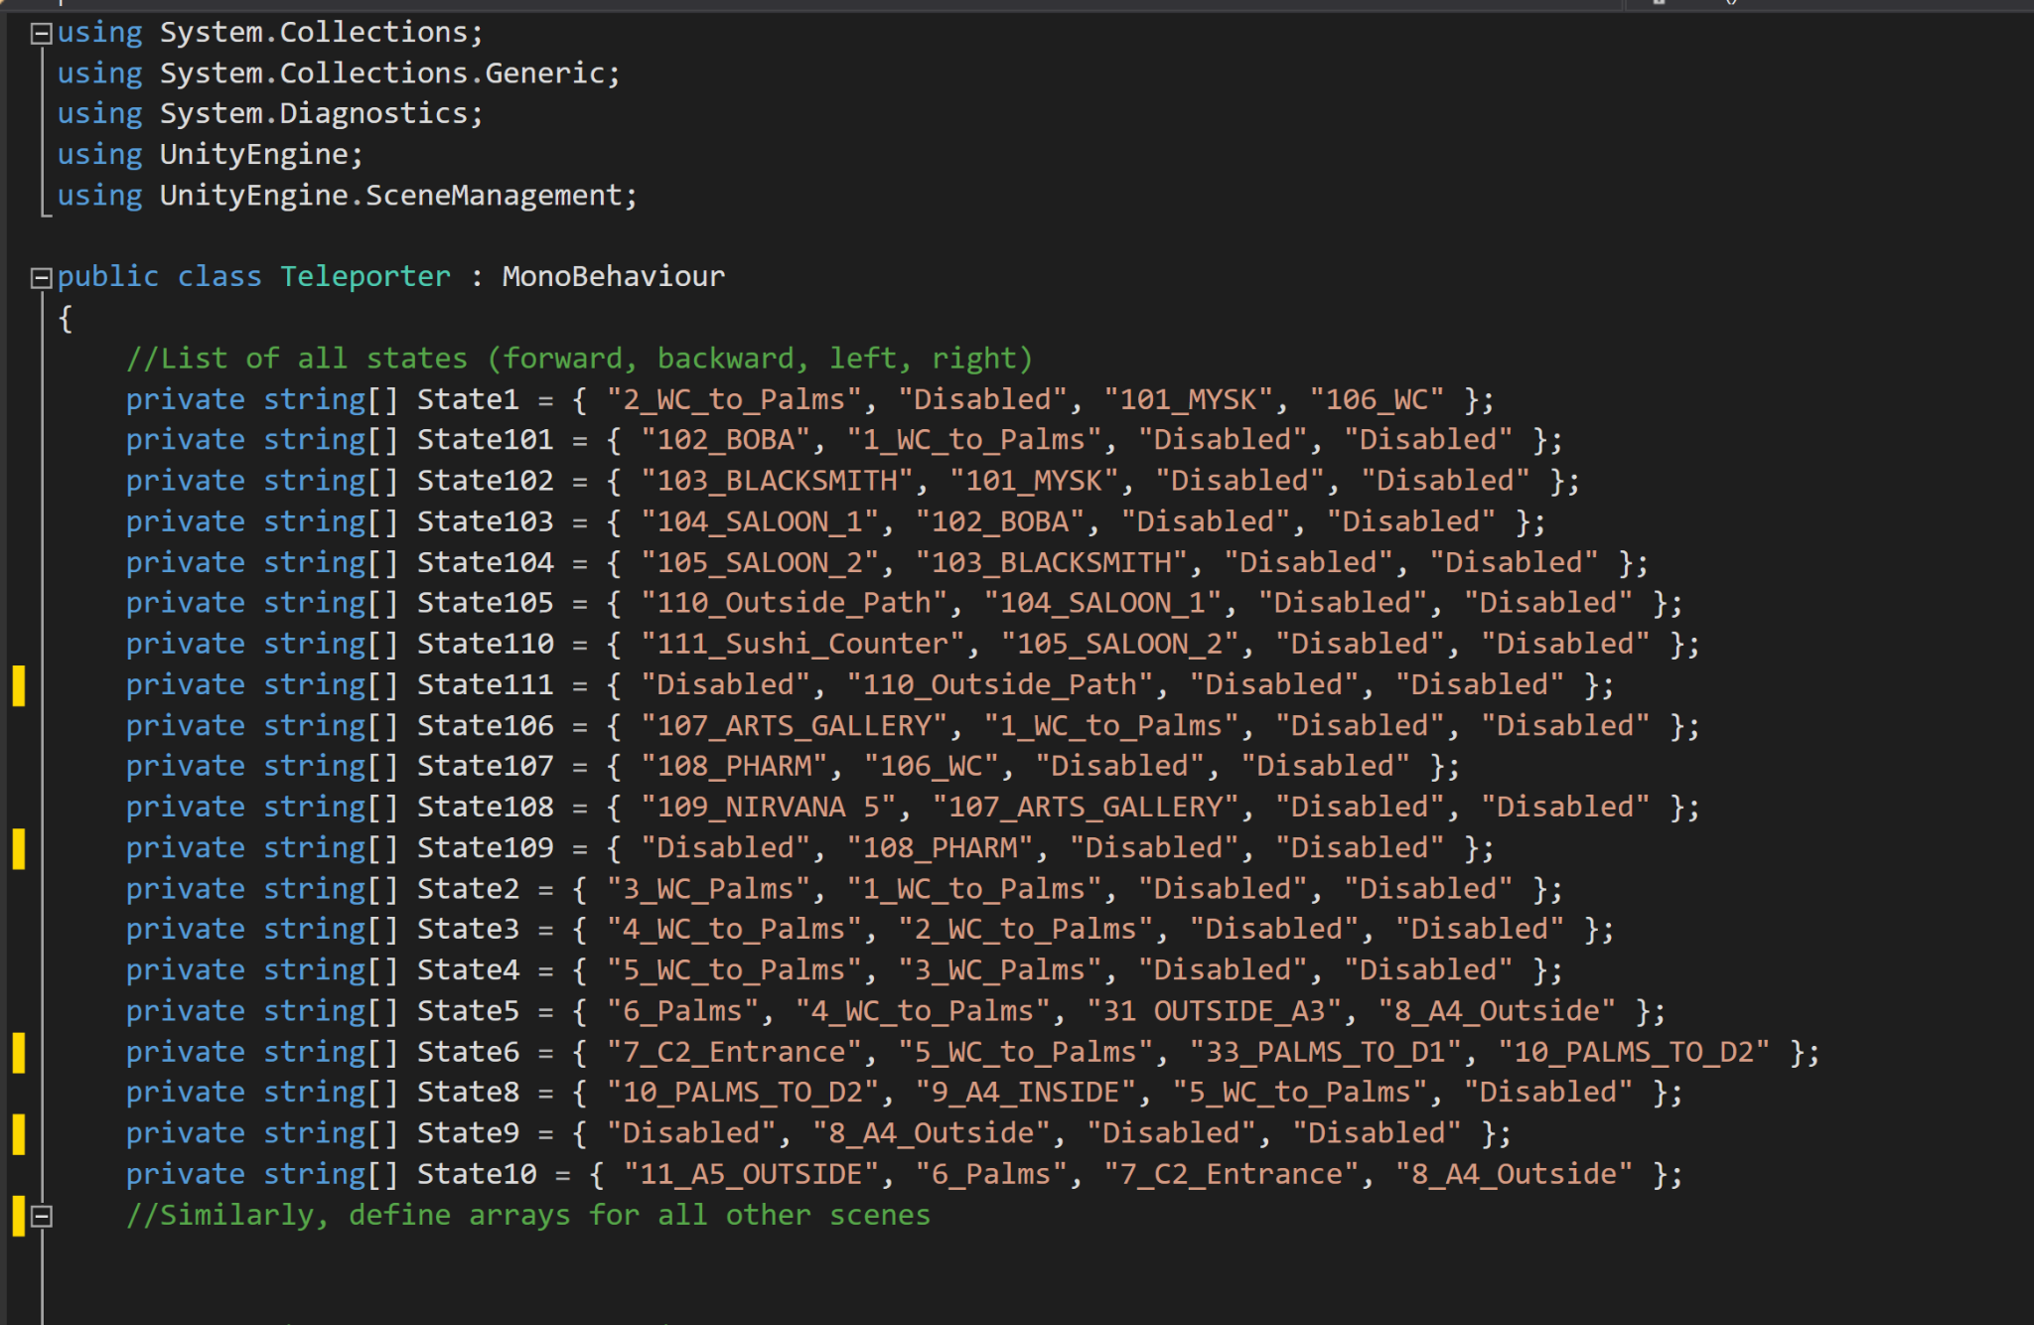
Teleporter Script
1.

Slide 13
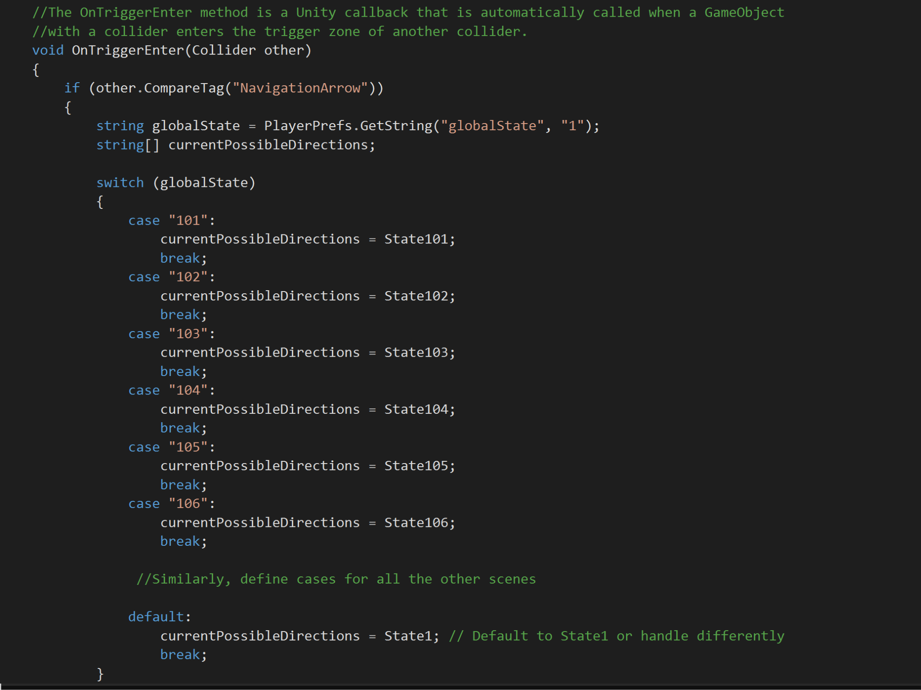
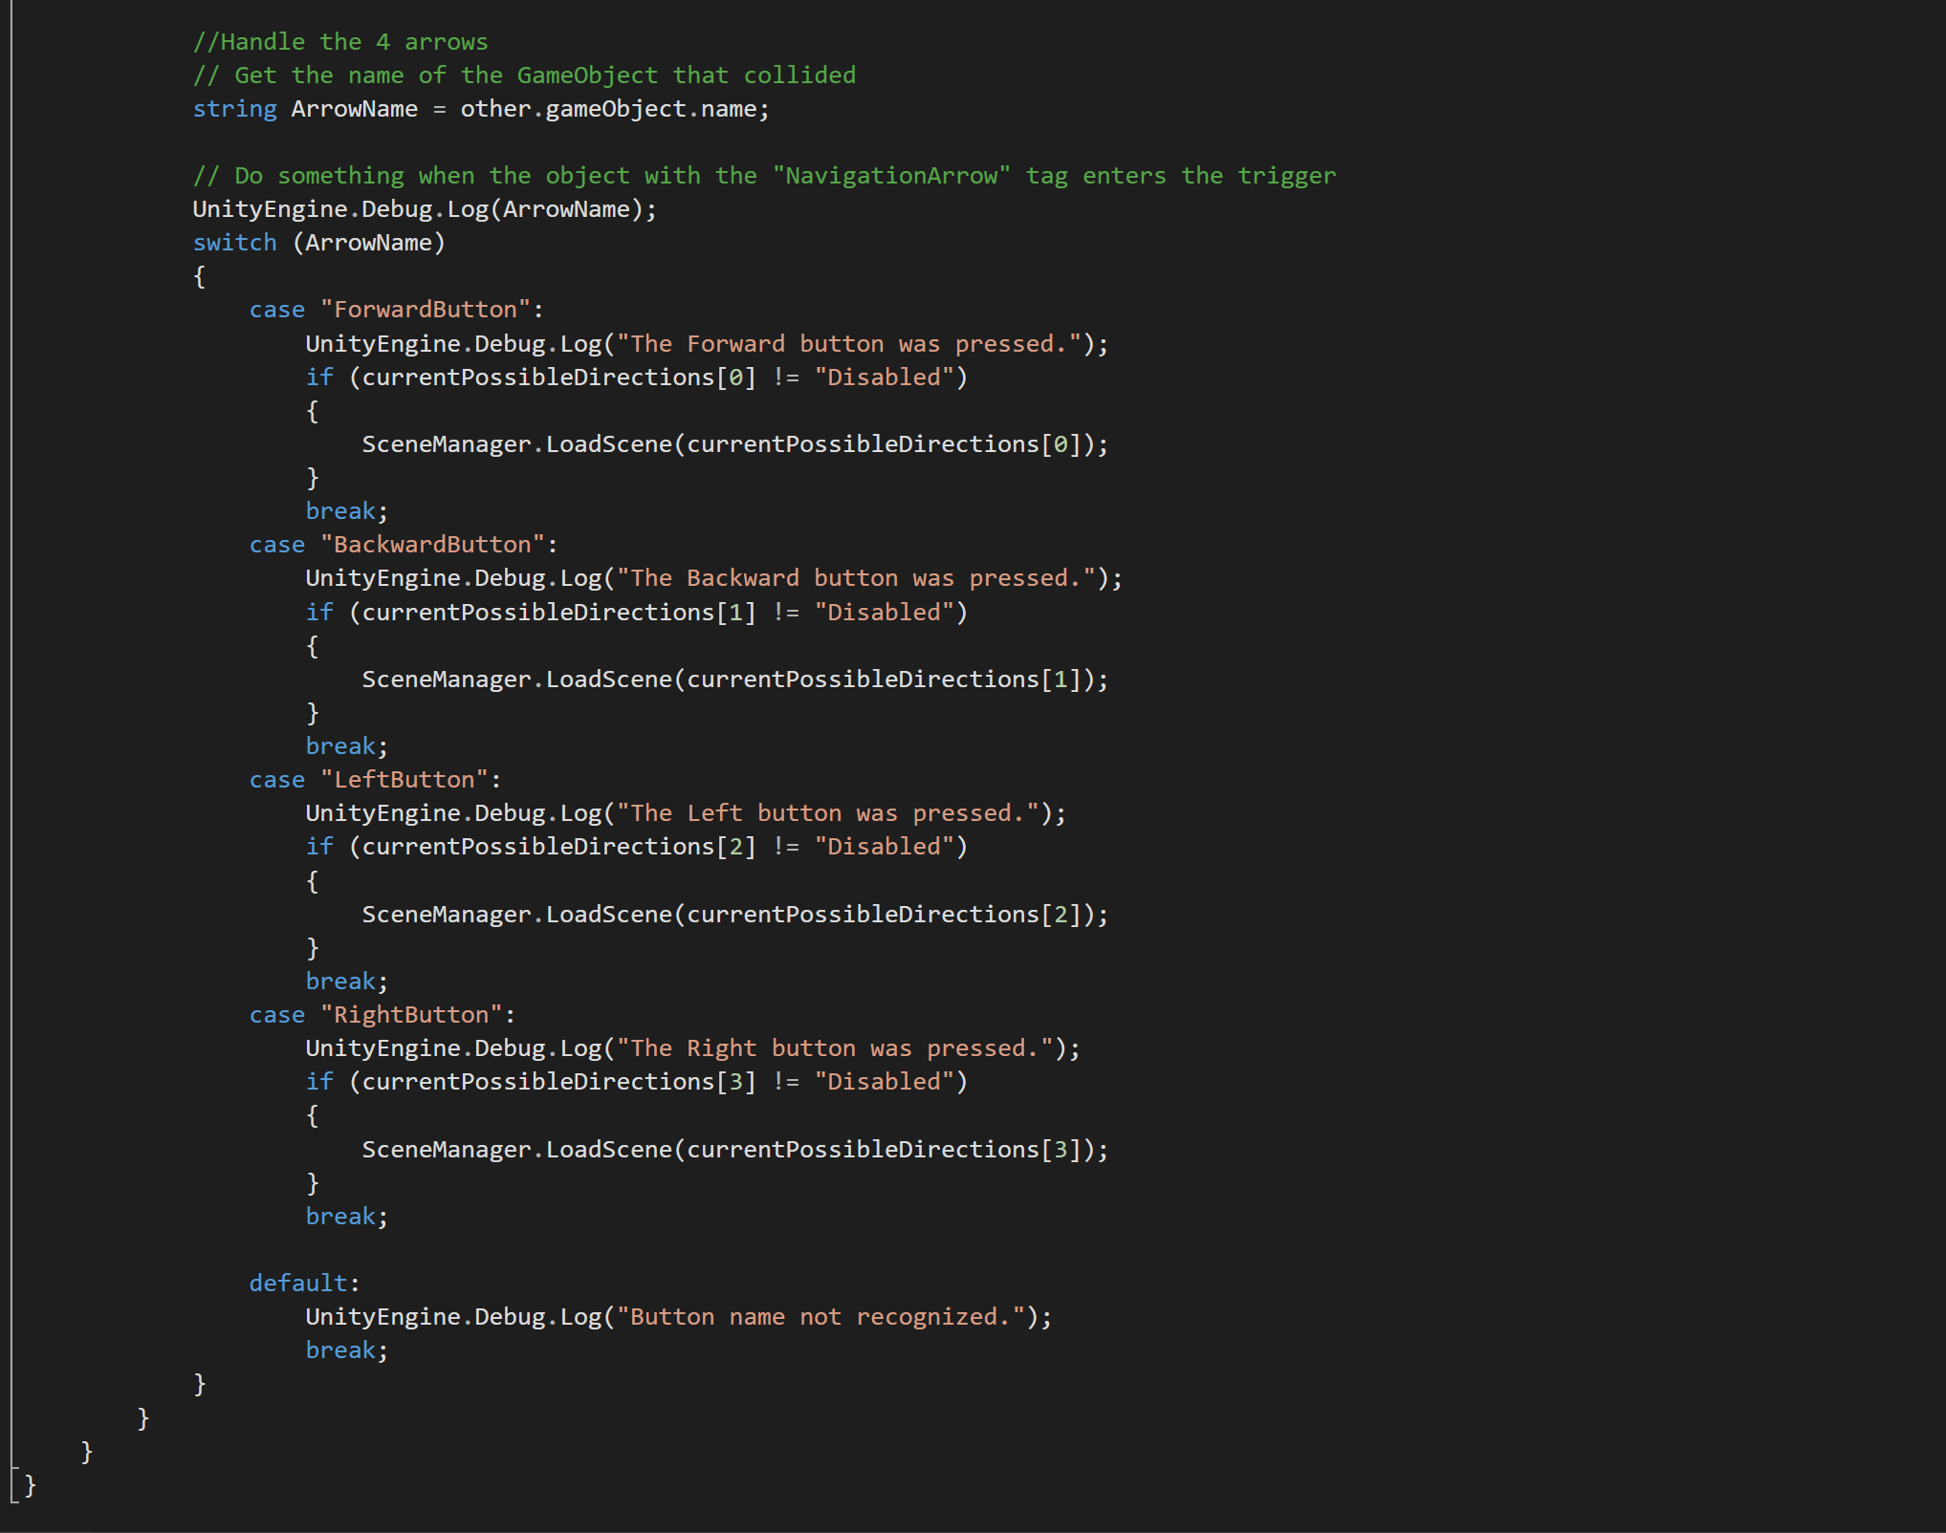
3.
2.

Slide 14
03
Conclusion

Slide 15
The Future
Multi-Campus Expansion
Dynamic Day-Night Cycle
Interactive Learning Modules:
Interactive Map Navigation
Student Ambassador Collaborations:
Interactive Tour Guide Character
Virtual Events in VR:
Additional Languages
Covering additional locations
There is a plethora of space for improvement and additional features in our program. Some of them are mentioned here-

Slide 16
Reflection on Learnings
VR Development Skills: Gained expertise in Unity and C# for creating immersive VR environments.
Ethical Awareness: Focused on ethical considerations in technology, particularly regarding consent in photography.
Inclusive Design: Emphasized accessible and inclusive design, integrating features like audio descriptions.
Team Collaboration: Enhanced collaborative skills with clear division of tasks among team members.
Adaptive Project Management: Developed problem-solving abilities in managing challenges like 360 imaging and ethical issues.
User-Centric Design: Focused on user-friendly interfaces and navigation for an engaging user experience

Slide 17
Contributions
Aman
Ashmit
Richmond
Major Responsibility: Coding and Programming
Minor Responsibility: Data Collection and Research
Major Responsibility: Audio Work and Multimedia Content Creation
Minor Responsibility: Graphic Design and User Interface (UI) Enhancements
Major Responsibility: Capturing 360 Pictures of the University
Minor Responsibility: Script and Dialogue Writing

Slide 18
References
https://www.youtube.com/watch?v=q0T-4_zUv8Y&amp;list=PmxqIl8EWtFjCcSd-AFuzW2es30NAobqf
https://www.youtube.com/watch?v=ZoZcBgRR9ns
https://www.youtube.com/watch?v=02NI9kwOOKo
https://sketchfab.com/360Degree-models/direction-arrow-6ef46718c7b242e39fcad7f27ee858a5
Text to Speech courtesy- Eleven Labs

Slide 19
Video Demonstration

Slide 20

THANK YOU!
We hope you liked our presentation.

